Slide 1
Information Retrieval Cycle
Source
Selection
Resource
Query
Formulation
Query
Search
Results
Selection
Documents
System discovery
Vocabulary discovery
Concept discovery
Document discovery
Examination
Information
source reselection
Delivery

Slide 2
IR Model - Boolean model
Each document or query is treated as a “bag” of words or terms.
A weight w_{ij} > 0 is associated with each term t of document D
Boolean Queries are queries using AND, OR and NOT to join query terms
Is precise: document matches condition or not (exact match)
Simplest IR model
Use cases - Email, library catalog, Mac OS X Spotlight
Weaknesses
Users must learn Boolean logic
Boolean logic insufficient to capture the richness of language
No control over size of result set: either too many hits or none
When do you stop reading? All documents in the result set are considered “equally good”
What about partial matches? Documents that “don’t quite match” the query may be useful also

Slide 3
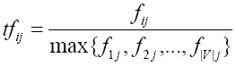
IR Model - Vector Space Model
Retrieve documents based on how close the document is to the query
Documents are also treated as a “bag” of words or terms.
Each document is represented as a vector.
However, the term weights are no longer 0 or 1.
Each term weight is computed based on some
variations of TF or TF-IDF scheme.
weight assigned to term i in document j
Term weights consist of two components
Term frequency : Local: how important is the term in this document?
Inverse document frequency : Global: how important is the term in the collection?
Terms that appear often in a document should get high weights
Terms that appear in many documents should get low weights
number of occurrence of term i in document j
number of documents in entire collection
number of documents with term i

Slide 4
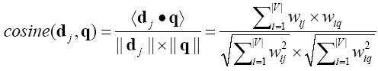
Retrieval in vector space model
Relevance of d_{i} to q: Cosine similarity (the cosine of the angle between the two vectors) commonly used in text clustering
Dot product
Cosine
Dice
Jaccard

Slide 5
An Example
A document space is defined by three terms:
hardware, software, users
the vocabulary
A set of documents are defined as:
A1=(1, 0, 0), A2=(0, 1, 0), A3=(0, 0, 1)
A4=(1, 1, 0), A5=(1, 0, 1), A6=(0, 1, 1)
A7=(1, 1, 1) A8=(1, 0, 1). A9=(0, 1, 1)
If the Query is “hardware and software”
what documents should be retrieved?
In Boolean query matching:
document A4, A7 will be retrieved (“AND”)
retrieved: A1, A2, A4, A5, A6, A7, A8, A9 (“OR”)
In similarity matching (cosine):
q=(1, 1, 0)
S(q, A1)=0.71,
S(q, A2)=0.71,
S(q, A3)=0,
S(q, A4)=1,
S(q, A5)=0.5,
S(q, A6)=0.5,
S(q, A7)=0.82,
S(q, A8)=0.5,
S(q, A9)=0.5
Document retrieved set (with ranking)=
{A4, A7, A1, A2, A5, A6, A8, A9}

Slide 6
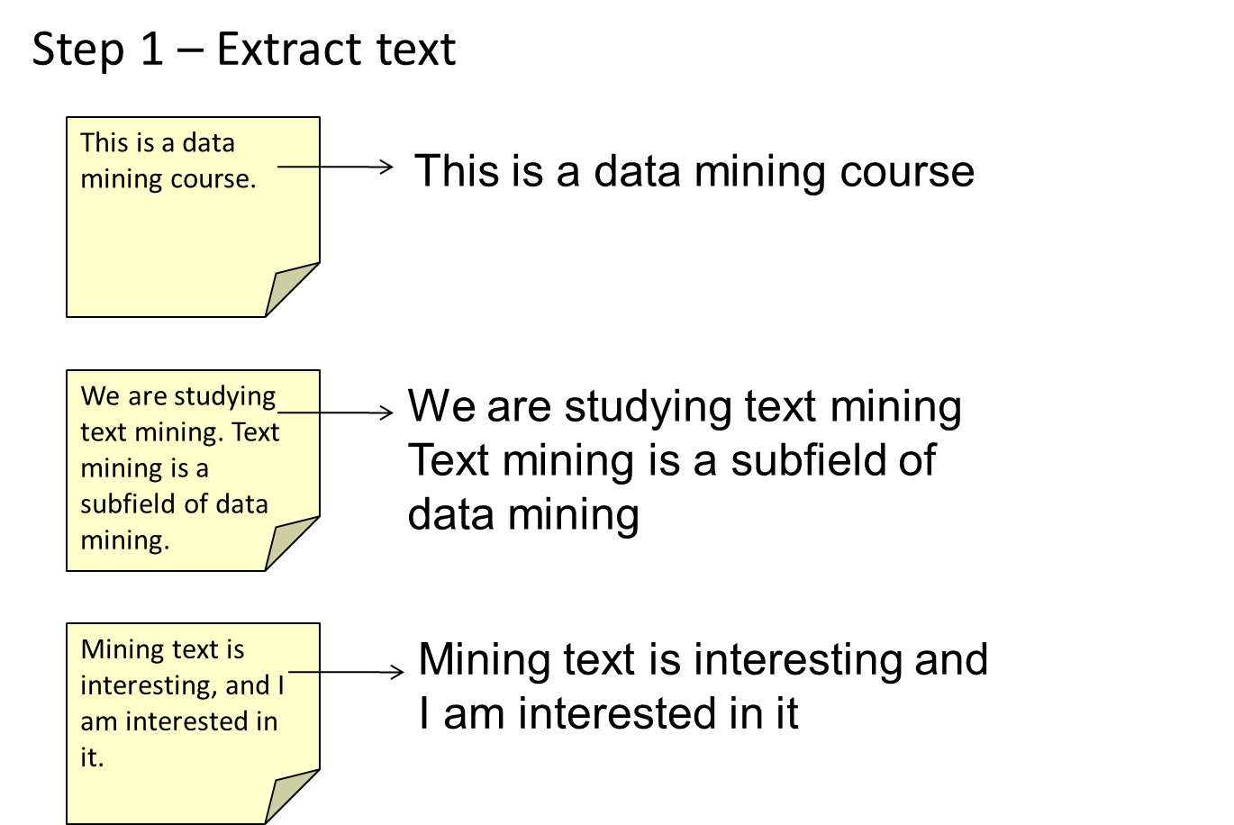
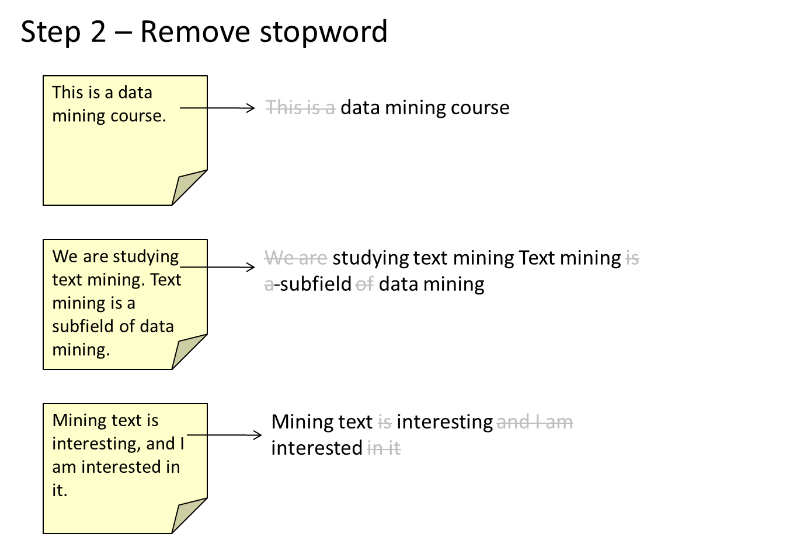
Vector Space Model: A Running Example

Slide 7
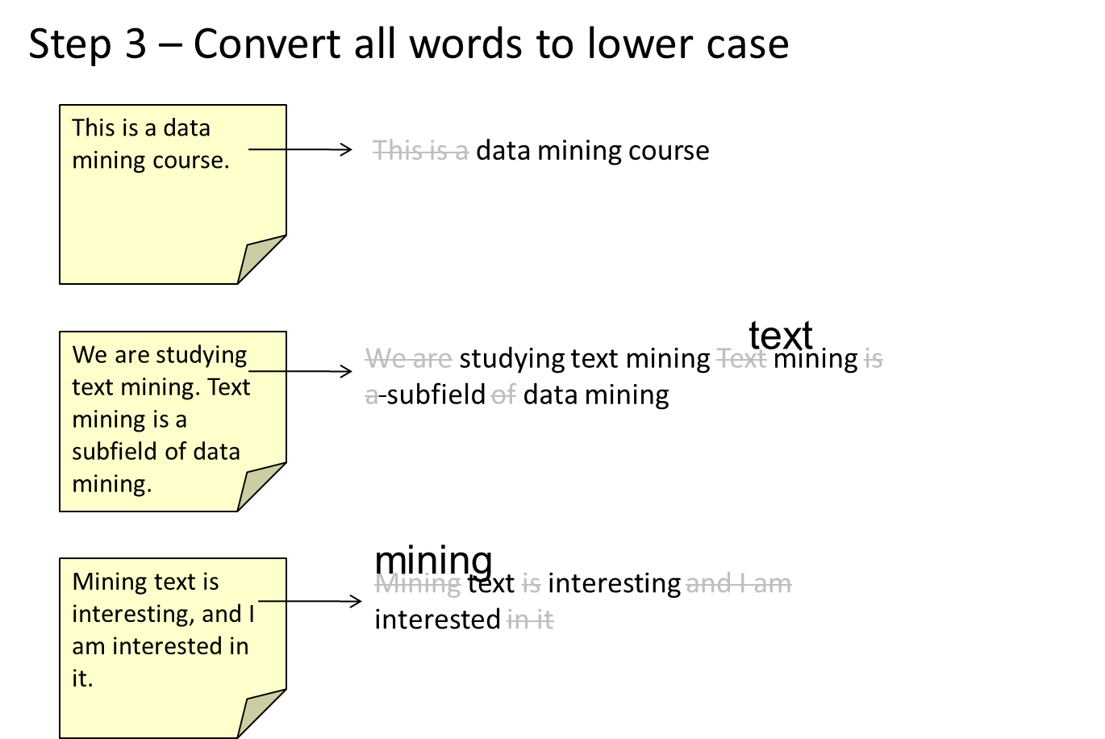
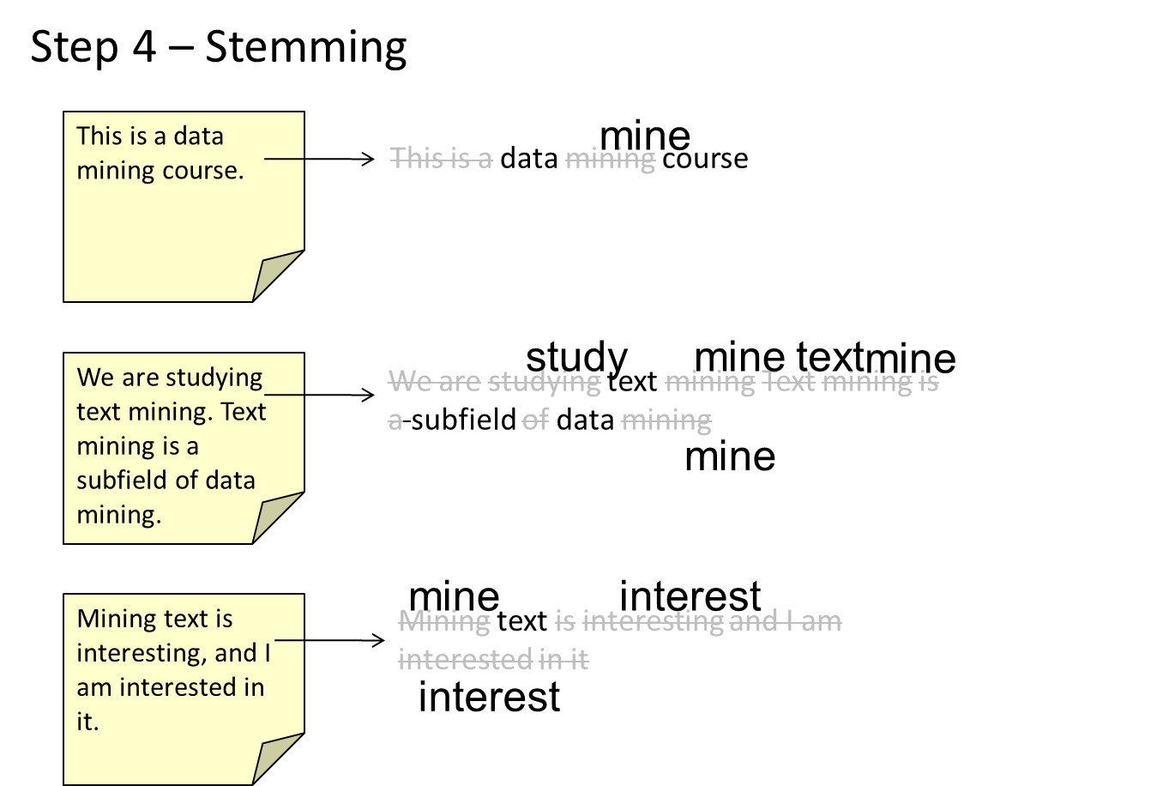
A Running Example

Slide 8
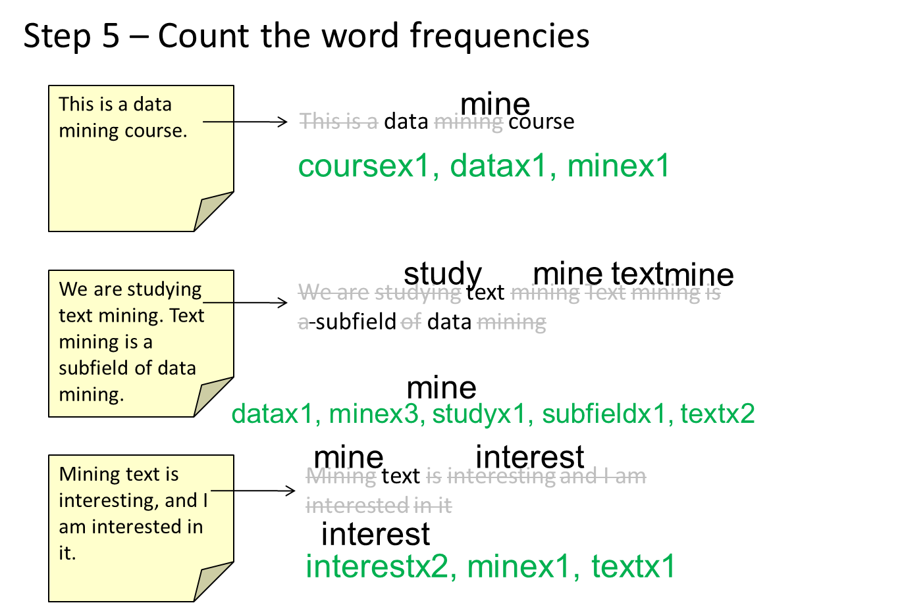
A Running Example

Slide 9
A Running Example
Step 6 – Create an indexing file
This is a data mining course.
mine
ID | word | doc freq
1 | course | 1
2 | data | 2
3 | interest | 1
4 | mine | 3
5 | study | 1
6 | subfield | 1
7 | text | 2
This is a data mining course
coursex1, datax1, minex1
study
mine
text
We are studying text mining. Text mining is a subfield of data mining.
We are studying text mining Text mining is a subfield of data mining
mine
mine
datax1, minex3, studyx1, subfieldx1, textx2
mine
interest
Mining text is interesting, and I am interested in it.
Mining text is interesting and I am interested in it
interest
interestx2, minex1, textx1

Slide 10
A Running Example
Step 7 – Create the vector space model
This is a data mining course.
mine
ID | word | document frequency
1 | course | 1
2 | data | 2
3 | interest | 1
4 | mine | 3
5 | study | 1
6 | subfield | 1
7 | text | 2
This is a data mining course
coursex1, datax1, minex1
(1, 1, 0, 1, 0, 0, 0)
study
mine
text
mine
We are studying text mining. Text mining is a subfield of data mining.
We are studying text mining Text mining is a subfield of data mining
mine
datax1, minex3, studyx1, subfieldx1, textx2
(0, 1, 0, 3, 1, 1, 2)
mine
interest
Mining text is interesting, and I am interested in it.
Mining text is interesting and I am interested in it
interest
interestx2, minex1, textx1
(0, 0, 2, 1, 0, 0, 1)

Slide 11
A Running Example
Step 8 – Compute the inverse document frequency
This is a data mining course.
ID | word | document frequency | IDF
1 | course | 1 | 0.477
2 | data | 2 | 0.176
3 | interest | 1 | 0.477
4 | mine | 3 | 0
5 | study | 1 | 0.477
6 | subfield | 1 | 0.477
7 | text | 2 | 0.176
(1, 1, 0, 1, 0, 0, 0)
We are studying text mining. Text mining is a subfield of data mining.
(0, 1, 0, 3, 1, 1, 2)
Mining text is interesting, and I am interested in it.
(0, 0, 2, 1, 0, 0, 1)

Slide 12
A Running Example
Step 9 – Compute the weights of the words
This is a data mining course.
(1, 1, 0, 1, 0, 0, 0)
ID | word | document frequency | IDF
1 | course | 1 | 0.477
2 | data | 2 | 0.176
3 | interest | 1 | 0.477
4 | mine | 3 | 0
5 | study | 1 | 0.477
6 | subfield | 1 | 0.477
7 | text | 2 | 0.176
(0.477, 0.176, 0, 0, 0, 0, 0)
We are studying text mining. Text mining is a subfield of data mining.
(0, 1, 0, 2, 1, 1, 2)
(0, 0.176, 0, 0, 0.477, 0.477, 0.352)
Mining text is interesting, and I am interested in it.
(0, 0, 2, 1, 0, 0, 1)
(0, 0, 0.954, 0, 0, 0, 0.176)
P. 12

Slide 13
A Running Example
Step 10 – Normalize all documents to unit length
This is a data mining course.
(1, 1, 0, 1, 0, 0, 0)
ID | word | document frequency | IDF
1 | course | 1 | 0.477
2 | data | 2 | 0.176
3 | interest | 1 | 0.477
4 | mine | 3 | 0
5 | study | 1 | 0.477
6 | subfield | 1 | 0.477
7 | text | 2 | 0.176
(0.938, 0.346, 0, 0, 0, 0, 0)
We are studying text mining. Text mining is a subfield of data mining.
(0, 1, 0, 3, 1, 1, 2)
(0, 0.225 0, 0, 0.611, 0.611, 0.450)
Mining text is interesting, and I am interested in it.
(0, 0, 2, 1, 0, 0, 1)
(0, 0, 0.983, 0, 0, 0, 0.181)

Slide 14
A few notes on BM25
Okapi BM25 (BM is an abbreviation of best matching) is a ranking function used by search engines to estimate the relevance of documents to a given search query.
BM25 is a bag-of-words retrieval function that ranks a set of documents based on the query terms appearing in each document, regardless of their proximity within the document.
It is based on the probabilistic retrieval framework

Slide 15
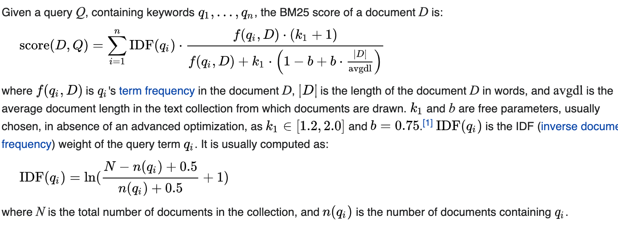
BM25 continued
The more words in common with query, the better.
Repetitions of query words is good
Squashing function-first word occurrence is most important
Common words less important
https://en.wikipedia.org/wiki/Okapi_BM25

Slide 16
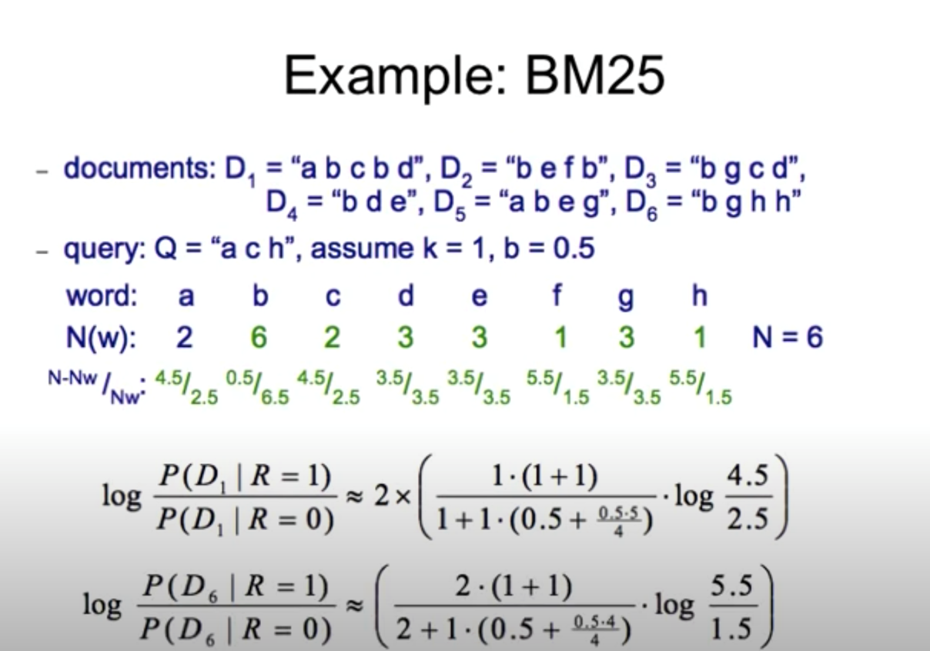


N: Total number of documents in the collection
avgdl: Average document length in the collection (here, avgdl = 4)
D(w): Number of documents containing the word w
idf(w): Inverse document frequency of word w, calculated as:
IDF(w) = Log((N – N(w) + b)/(N(w) + b))
IDF(w) = Log((6 – N(w) + .5)/(N(w) + .5))
dl(D): Length of document D
N=6 avgdl=4
BM25(Q,D1) = Sum of all matching terms calculates using : (D1(w)*(1+k)/(D1(w)+ k((1-b)+ (b*dl(D1)/avgdl))))* log(idf(w))
Query Q = "a c h" , Document D1 = "abcbd"
D1(a) = 1, D1(c) = 1, D1(h) = 0 (since "h" is not in D1) , dl(D1) = 5 (length of D1)
BM25(Q,D1)= (1*(1+1)/(1+1*(.5+(.5-5)/4)))*log(4.5/2.5) + (1*(1+1)/(1+1*(.5+(.5-5)/4)))* log(4.5/2.5)
Query Q = "a c h" , Document D6 = “bghh"
D1(a) = 0, D1(c) = 0, D1(h) = 2, dl(D6) = 5 (length of D6)
BM25(Q,D6)= (2*(1+1)/(2+1*(.5+(.5-5)/4)))*log(5.5/1.5)

Slide 17
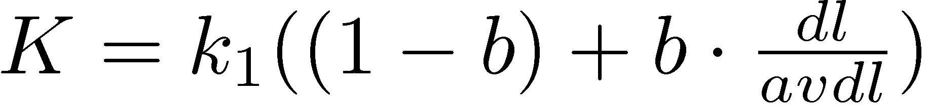
k1, k2 and K are parameters whose values are set empirically & dl is doc length
BM25 Example:
Query with two terms, “president lincoln”, (qf = 1)
No relevance information (r and R are zero)
N = 500,000 documents
“president” occurs in 40,000 documents (n₁ = 40, 000)
“lincoln” occurs in 300 documents (n₂ = 300)
“president” occurs 15 times in doc (f₁ = 15)
“lincoln” occurs 25 times (f₂ = 25)
document length is 90% of the average length (dl/avdl = .9)
k₁ = 1.2, b = 0.75, and k₂ = 100
K = 1.2 · (0.25 + 0.75 · 0.9) = 1.11

Slide 18
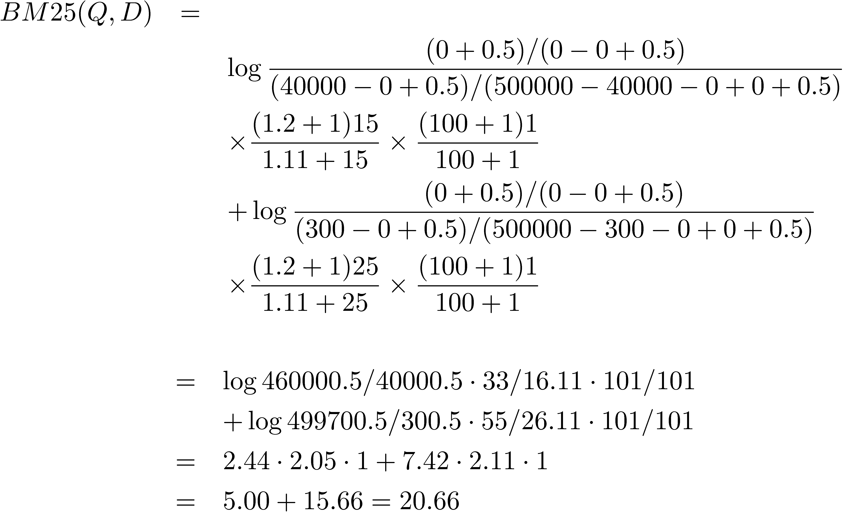
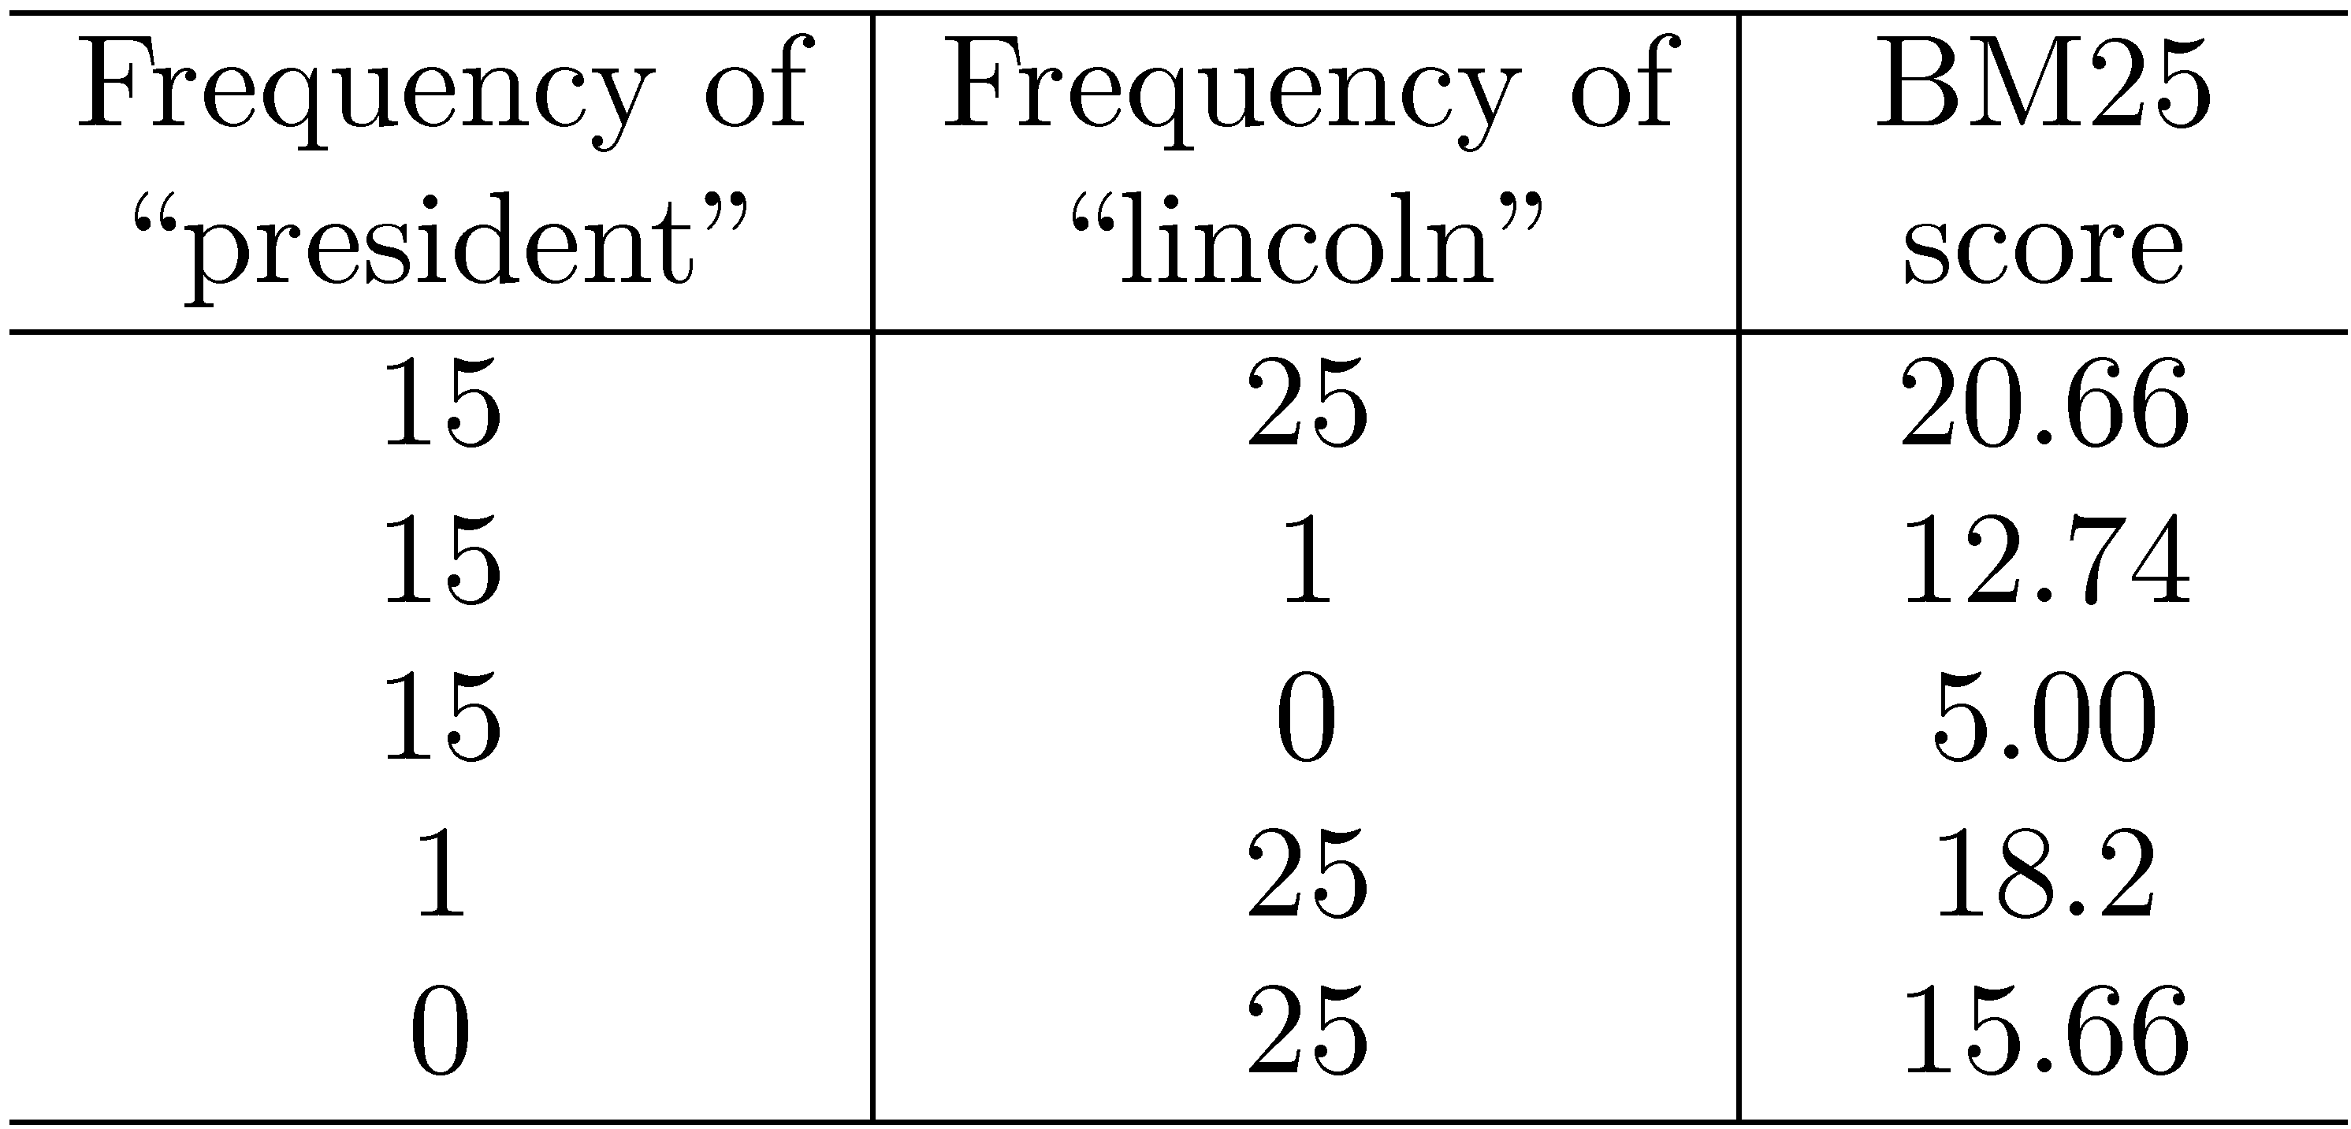
BM25 Example

Slide 19
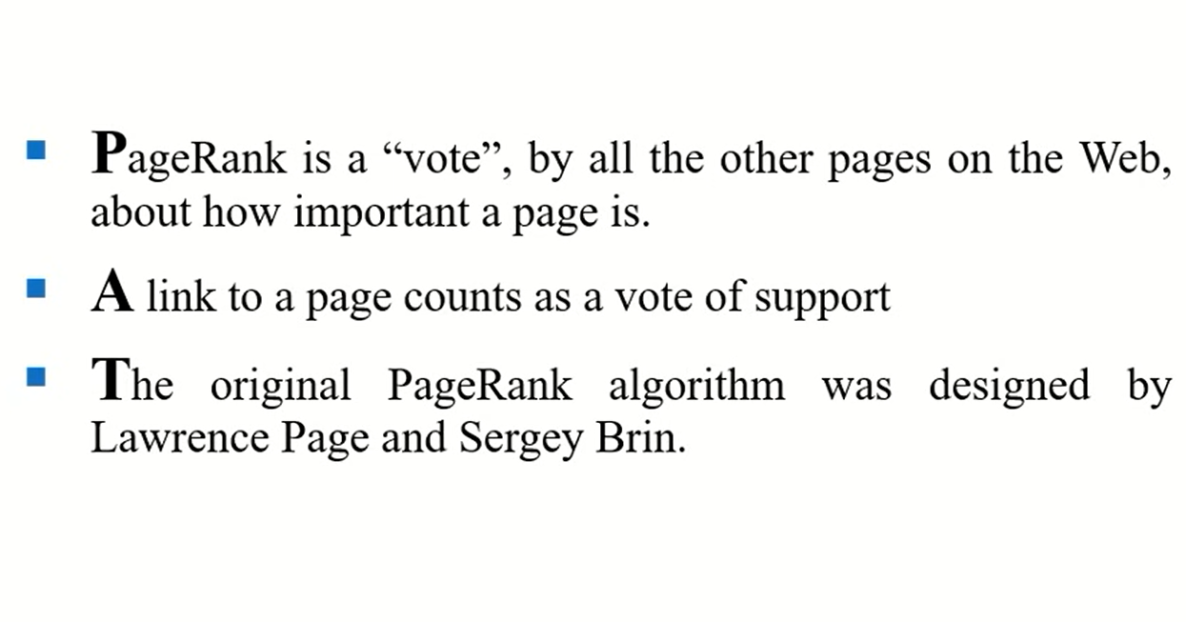
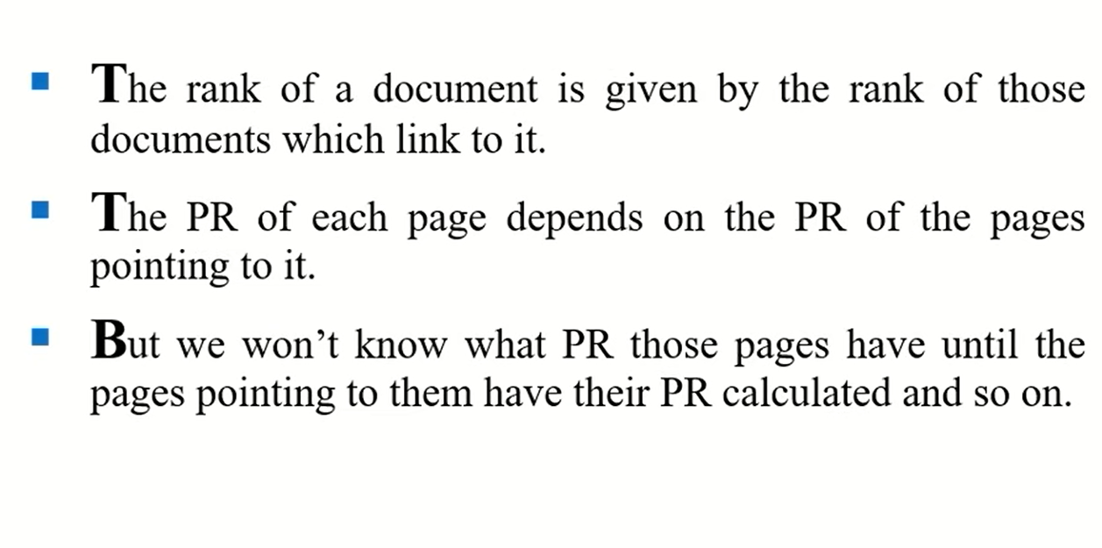
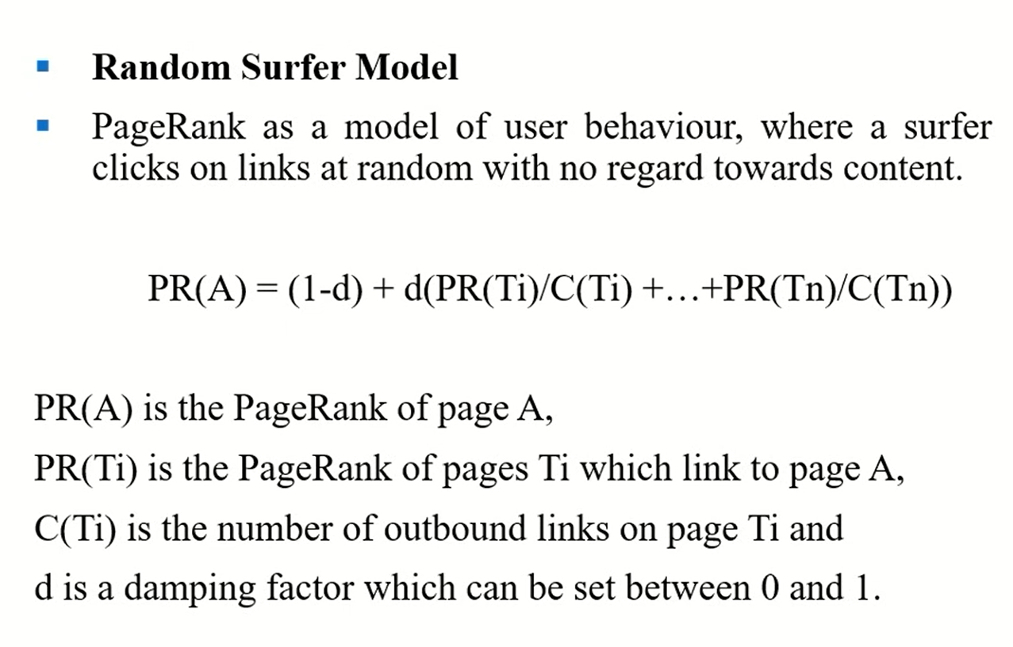
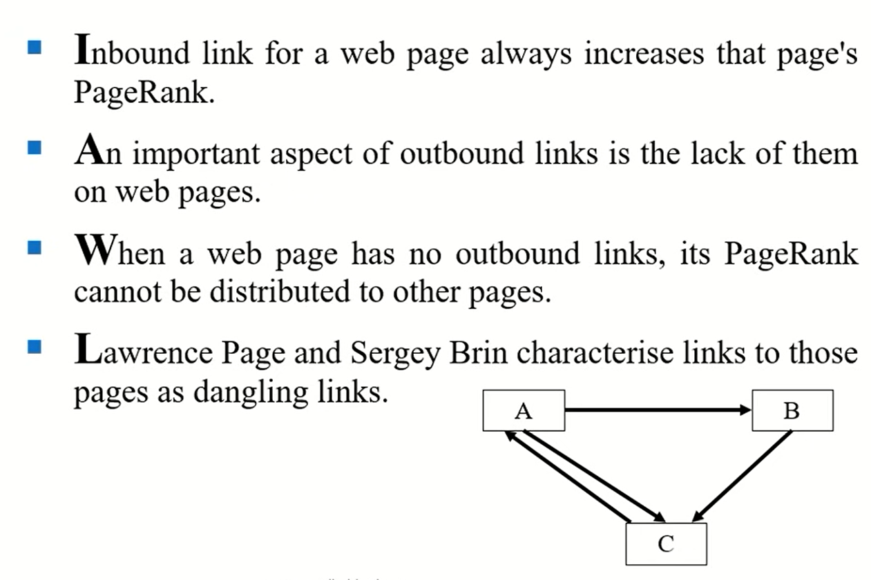
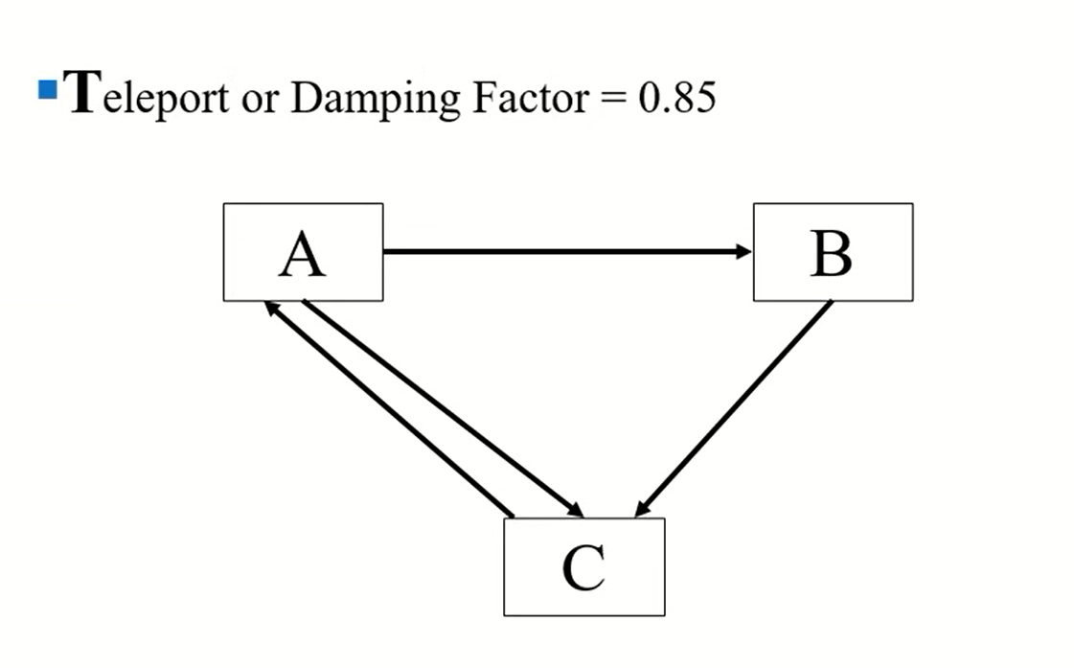
PAGE RANK ALGORITHM

Slide 20
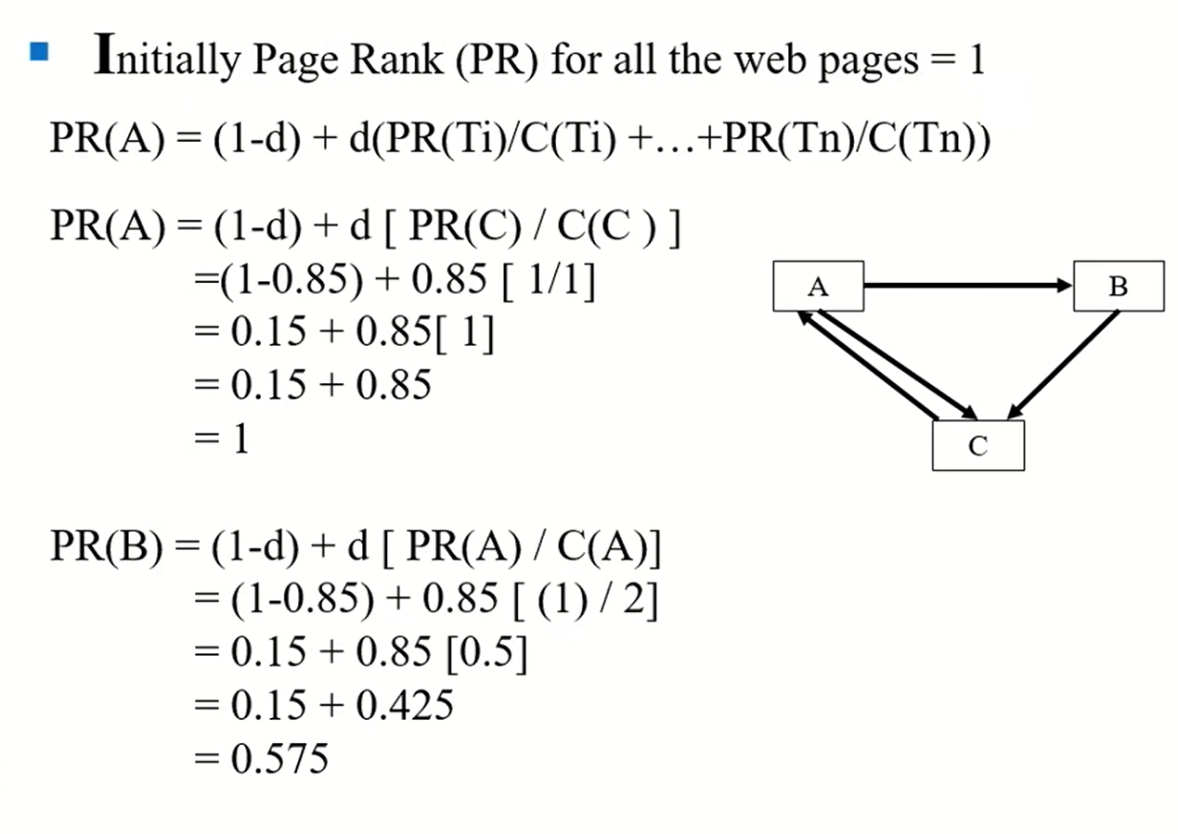
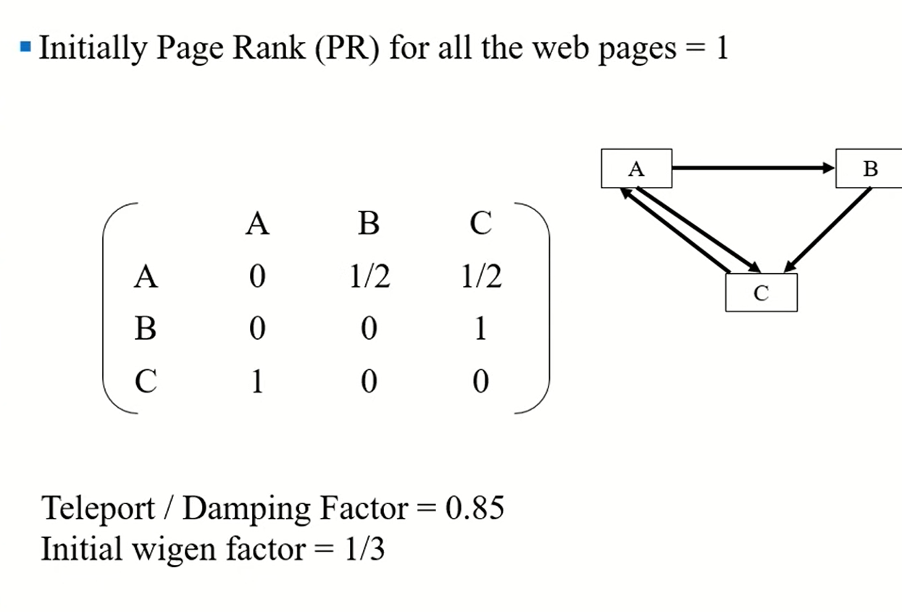
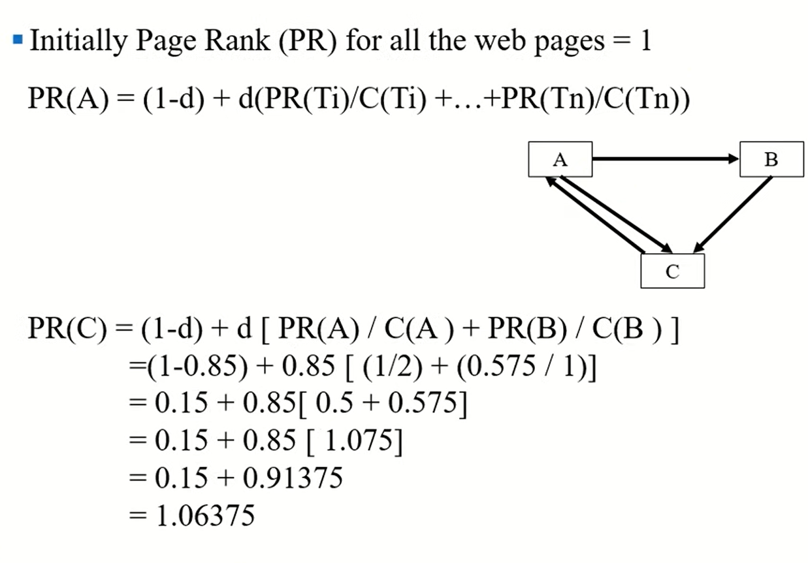

Slide 21
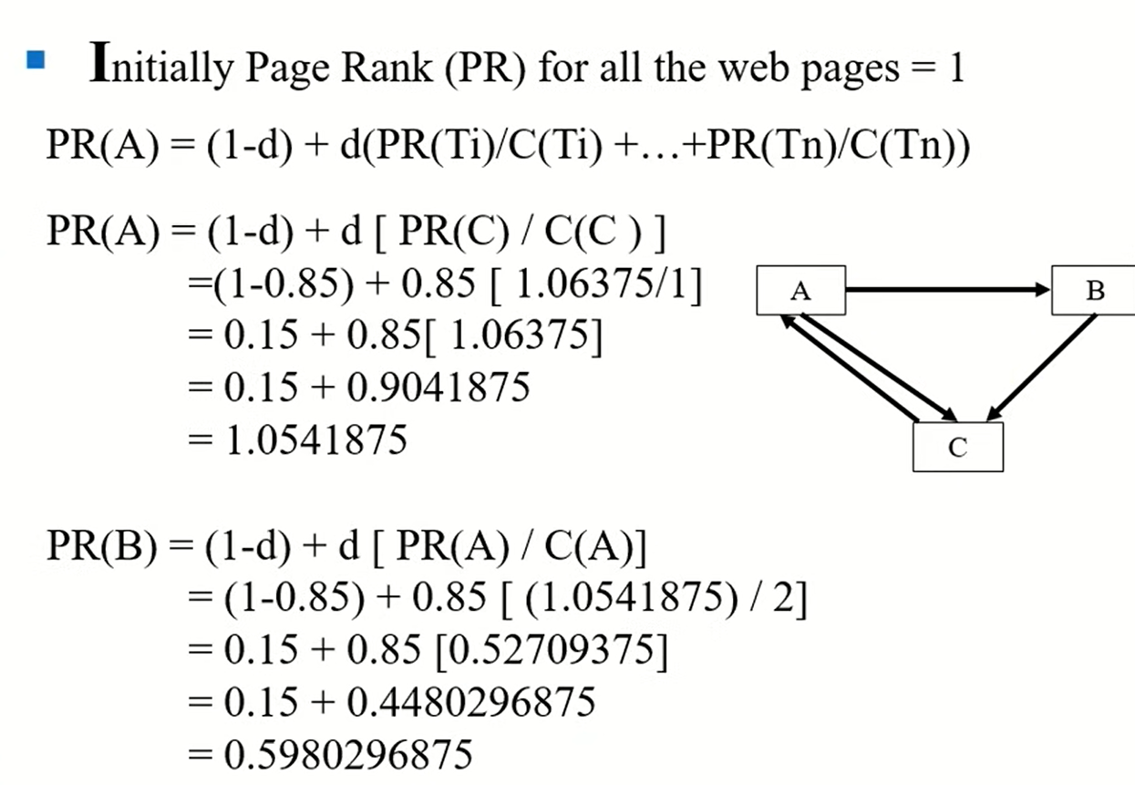
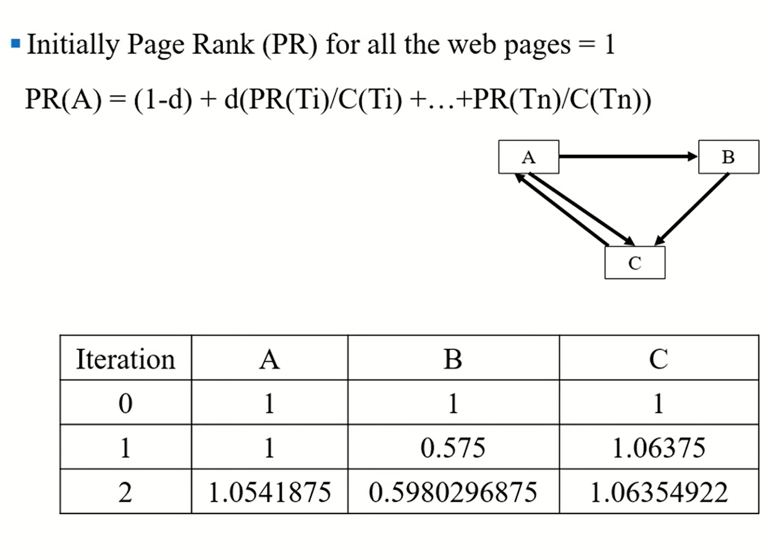
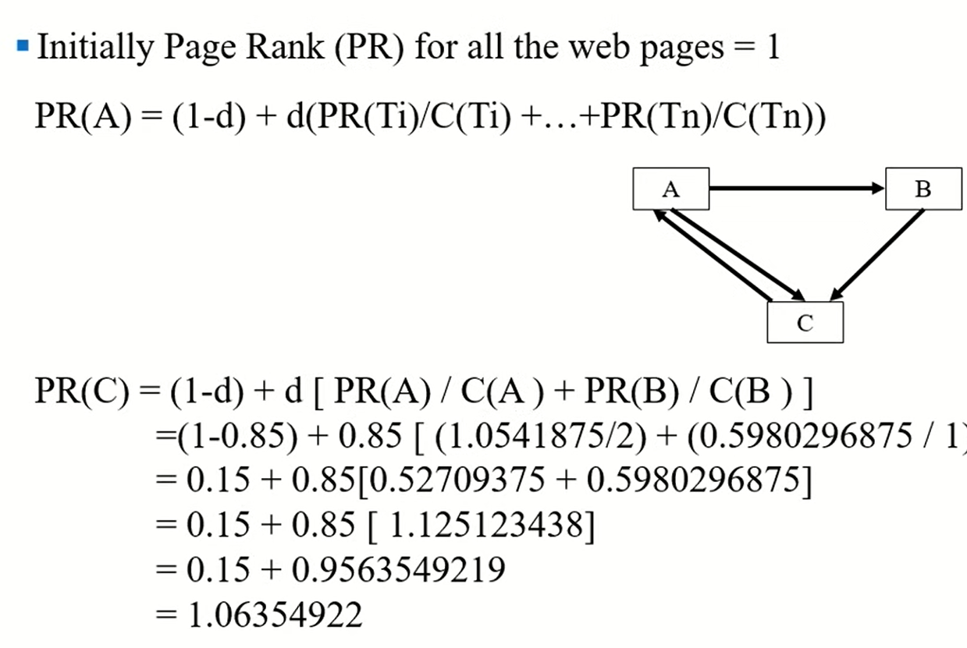

Slide 22
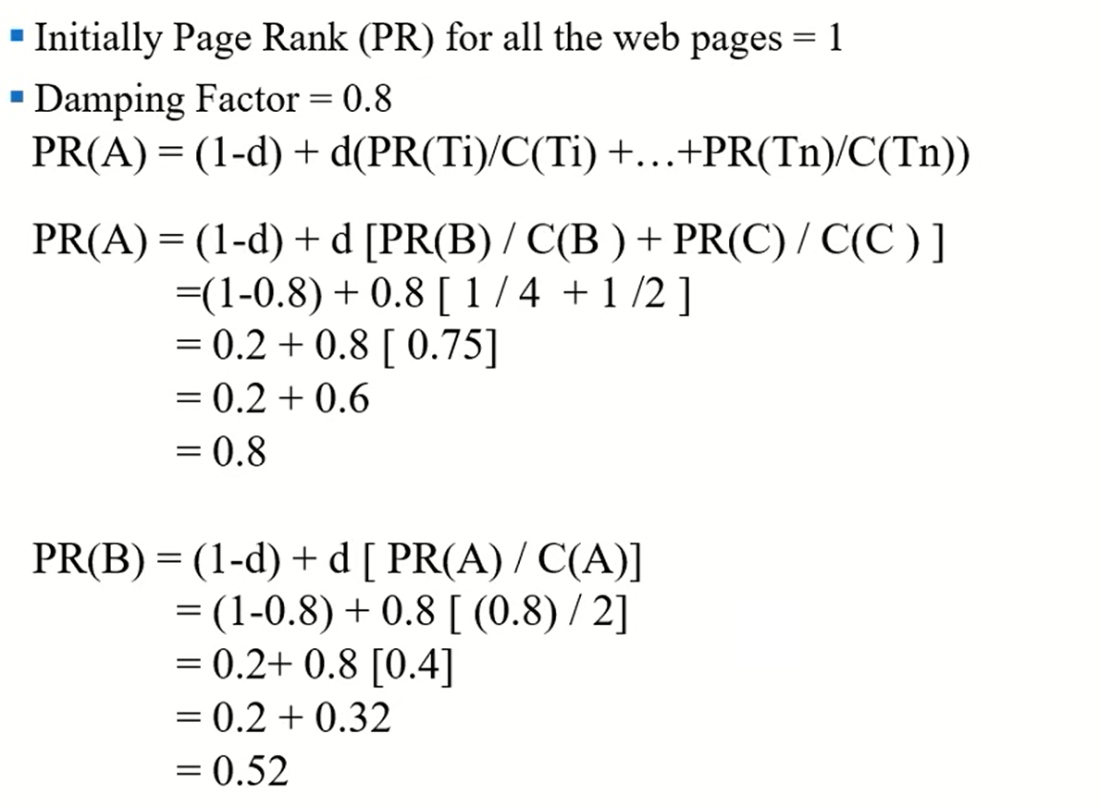
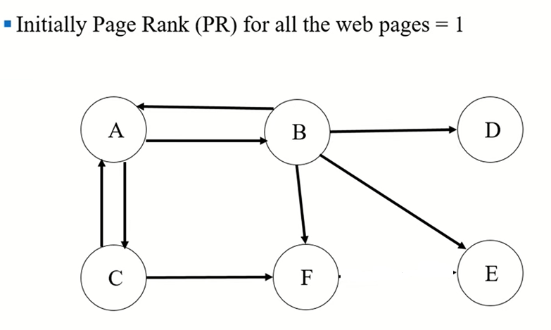
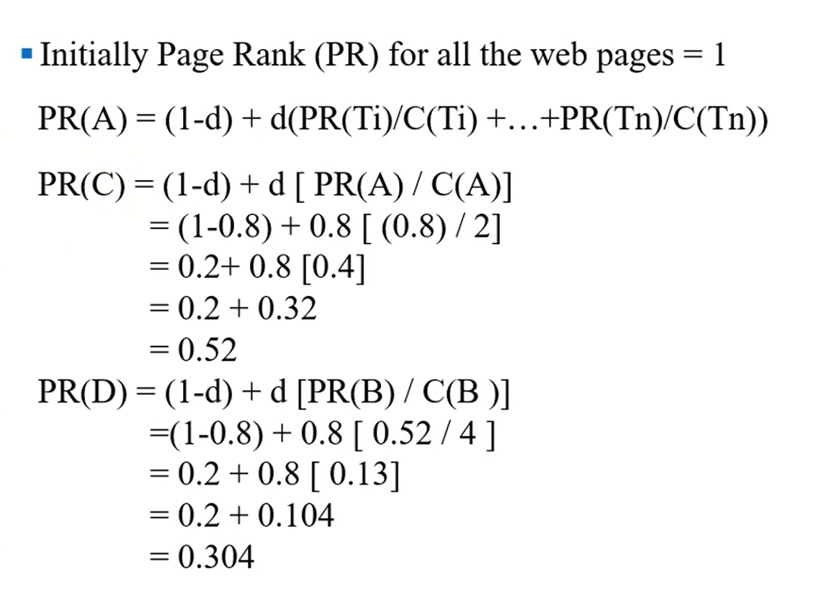

Slide 23
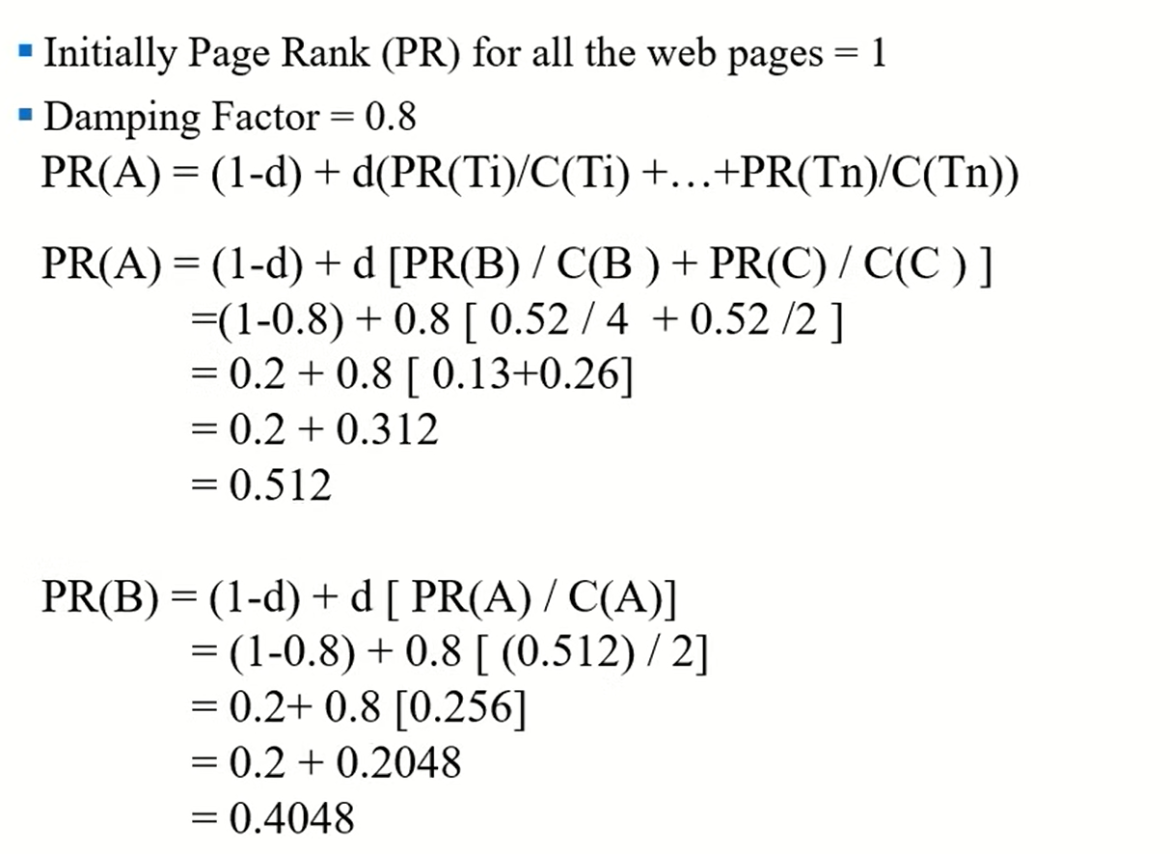
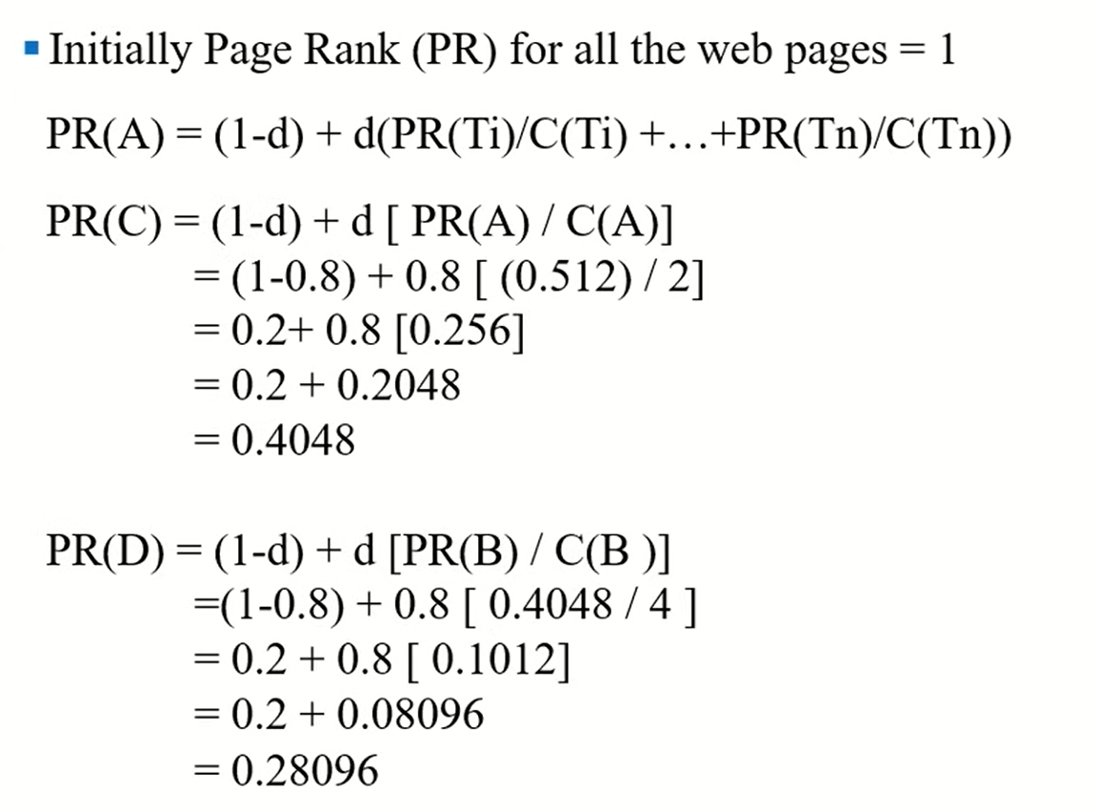
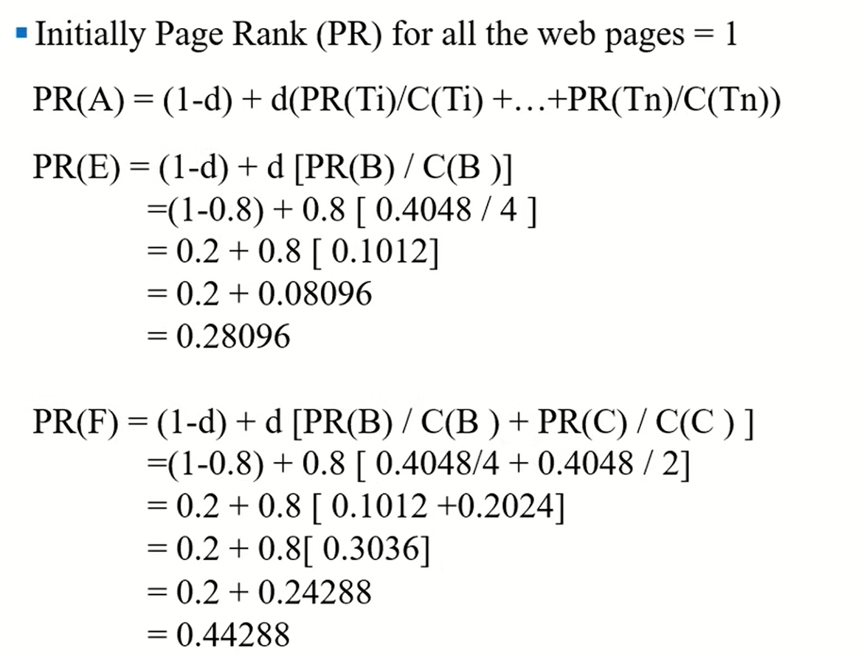
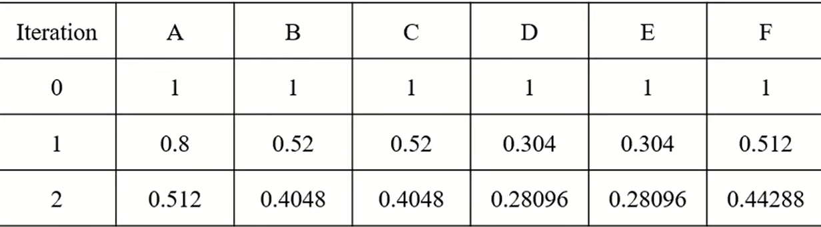

Slide 24
Example problems
1.An IR system returns 12 relevant documents and 10 irrelevant documents. There are a total of 25 relevant documents in the collection. What is the precision of the system on this search and what is the recall.
Precision = (Number of relevant items retrieved) / (Total number of retrieved items)
Recall = (Number of relevant items retrieved) / (Total number of relevant items)
Precision = 12 / 22
Recall = 12 / 25

Slide 25
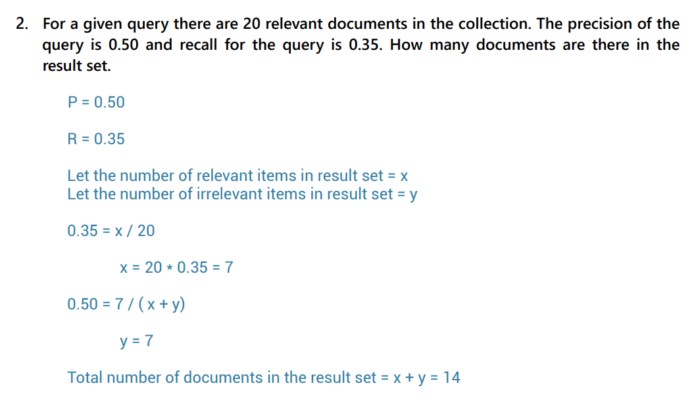

Slide 26
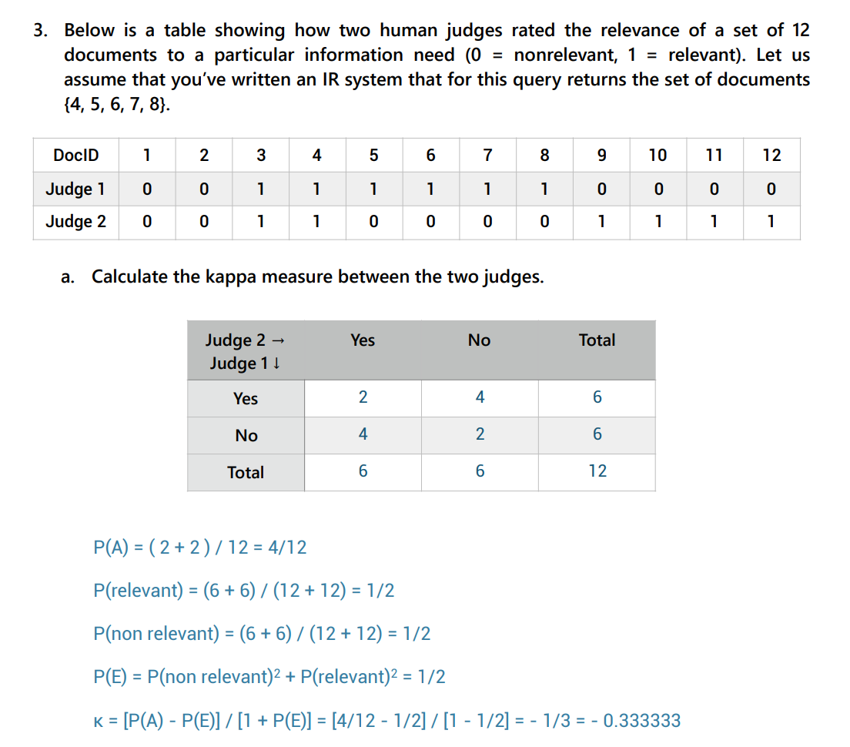

Slide 27
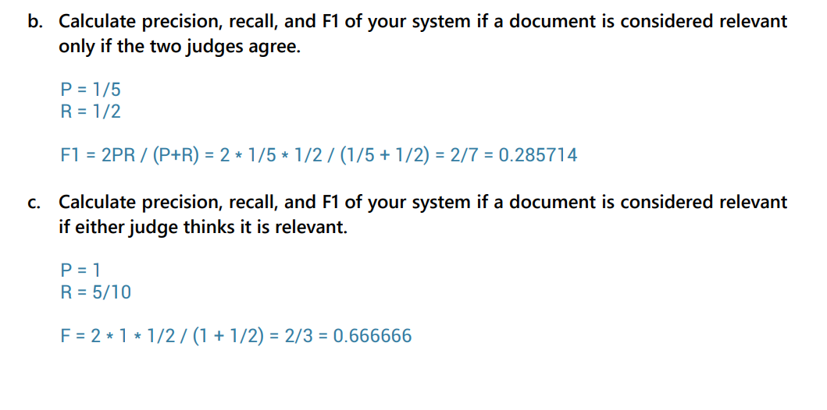

Slide 28
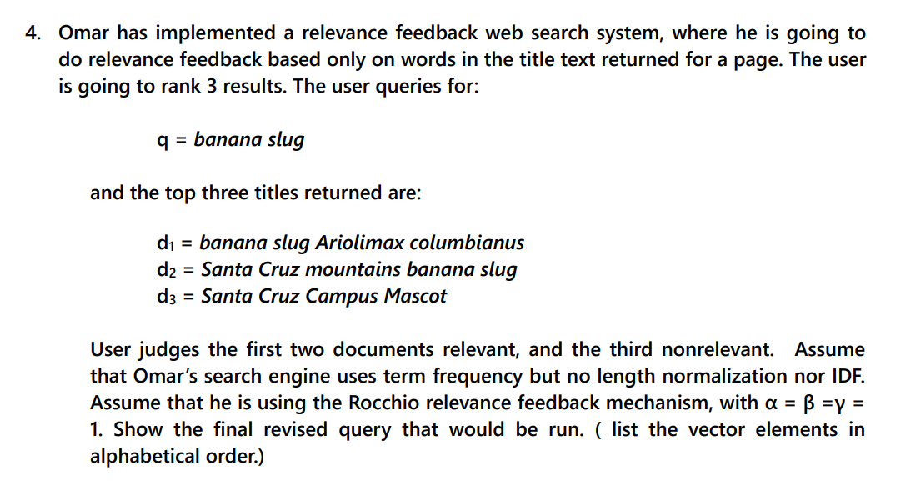

Slide 29
